Slide 1
Software Engineering
Wei-Min Wu（吴为民）
School of Petroleum
China University of Petroleum - Beijing at Karamay
Fall, 2025

Slide 2
Chap. 7 Design and implementation
Topics covered 覆盖主题
Object-oriented design using the UML 使用UML的面向对象设计
Design patterns 设计模式
Implementation issues 实现问题
Open source development 开源开发（留作自学）

Slide 3
Chap. 7 Design and implementation
Design and implementation 设计和实现
Software design and implementation is the stage in the software engineering process at which an executable software system is developed. 含义
Software design and implementation activities are invariably interleaved. Software design is a creative activity in which you identify software components and their relationships, based on a customer’s requirements; Implementation is the process of realizing the design as a program. 两个过程相互交织
Design and implementation are closely linked, and you should normally take implementation issues into account when developing a design.两者紧密关联

Slide 4
Chap. 7 Design and implementation
Build or buy 构建或购买
One of the most important decisions made at an early stage of a software project is whether to build or to buy the application software. 早期最重要的决策
For many types of application, it is now possible to buy off-the-shelf application systems that can be adapted and tailored to the users’ requirements. 购买成品应用，可改编、剪裁
e.g., if you want to implement a medical records system, you can buy a package that is already used in hospitals. It is usually cheaper and faster to use this approach rather than developing a new system in a conventional programming language. 便宜、快
When you develop an application system by reusing an off-the-shelf product, the design process focuses on how to configure the system product to meet the application requirements. You don’t develop design models of the system. 若复用软件成品,就关注配置

Slide 5
Chap. 7 Design and implementation
7.1 Object-oriented design using the UML 使用UML的面向对象设计
Object-oriented design processes involve designing object classes and the relationships between these classes. These classes define the objects in the system and their interactions. When the design is realized as an executing program, the objects are created dynamically from these class definitions. OOD含义:设计对象类及其相互关系
Objects include both data and operations to manipulate that data. They may be understood and modified as stand-alone entities. There is often a clear mapping between real-world entities and their controlling objects in the system. This improves the understandability, and hence the maintainability, of the design. 对象包括数据和操作。现实世界实体与系统控制对象之间有清晰的映射

Slide 6
Chap. 7 Design and implementation
Process stages 过程阶段
To develop a system design from concept to detailed, object-oriented design, you need to: 从概念到详细ODD
Understand and define the context and the external interactions with system; 理解和定义上下文和外界与系统的交互
Design the system architecture; 设计系统体系结构
Identify the principal objects in the system; 识别主要对象
Develop design models; 开发设计模型
Specify interfaces. 刻画接口
Here explain object-oriented software design by developing a design for part of the embedded software for the wilderness weather station that was introduced in Chapter 1. deployed in remote areas, records local weather information and periodically transfers this to a weather information system, using a satellite link. 以野外气象站为例解释OOD

Slide 7
Chap. 7 Design and implementation
System context and interactions 系统上下文和交互
The first stage: understanding the relationships between the software that is being designed and its external environment. This is essential for deciding how to provide required functionality and how to structure the system to communicate with environment. 第一步:理解软件与外部环境的关系
Understanding the context also lets you establish the boundaries of the system, which helps you decide what features are implemented in the system and what features are in other associated systems. In this case, you need to decide how functionality is distributed between the control system for all of the weather stations and the embedded software in the weather station itself. 确立边界,有助于决定：实现哪些特征,哪些特征是其他系统的

Slide 8
Chap. 7 Design and implementation
Context models and interaction models 上下文模型和交互模型
System context models and interaction models present complementary views of the relationships between a system and its environment: 上下文模型和交互模型对系统与环境的关系，呈现互补的视图
A system context model is a structural model that demonstrates the other systems in the environment of the system being developed; 上下文模型：结构化模型
An interaction model is a dynamic model that shows how the system interacts with its environment as it is used. 交互模型：动态模型

Slide 9
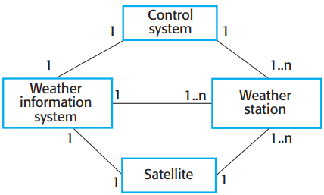

Chap. 7 Design and implementation
System context for the weather station 气象站的系统上下文
* The context model of a system may be represented using associations.
* Associations simply show that there are some relationships between the entities involved in the association.
* You can document the environment of the system using a simple block diagram, showing the entities in the system and their associations.
* Fig. 7.1 shows that the systems in the environment of each weather station are a weather information system, an onboard satellite system, and a control system. The cardinality information on the link shows that there is a single control system but several weather stations, one satellite, and one general weather information system.

Slide 10
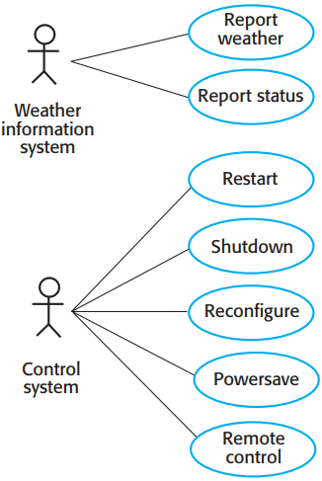

Chap. 7 Design and implementation
Weather station use case气象站用例
* When model the interactions of a system with its environment, one way is to use a use case model. Each use case represents an interaction with the system. Each possible interaction is named in an ellipse, and the external entity is represented by a stick figure.
* The use case model for the weather station is shown in Figure 7.2. This shows that the weather station interacts with the weather information system to report weather data and the status of the weather station hardware. Other interactions are with a control system that can issue specific weather station control commands. The stick figure is used in the UML to represent other systems as well as human users.
* Each of these use cases should be described in structured natural language. This helps designers identify objects in the system and gives them an understanding of what the system is intended to do. Figure 7.3 shows the Report weather use case.

Slide 11

Chap. 7 Design and implementation
Use case description-Report weather 用例描述-报告天气
System | Weather station
Use case | Report weather
Actors | Weather information system, Weather station
Description | The weather station sends a summary of the weather data that has been collected from the instruments in the collection period to the weather information system. The data sent are the maximum, minimum, and average ground and air temperatures; the maximum, minimum, and average air pressures; the maximum, minimum, and average wind speeds; the total rainfall; and the wind direction as sampled at 5-minute intervals.
Stimulus | The weather information system establishes a satellite communication link with the weather station and requests transmission of the data.
Response | The summarized data is sent to the weather information system.
Comments | Weather stations are usually asked to report once per hour but this frequency may differ from one station to another and may be modified in future.

Slide 12
Chap. 7 Design and implementation
Architectural design 结构设计
Once the interactions between the software system and the system’s environment have been defined, you use this information as a basis for designing the system architecture. 定义好软件与环境的交互后，该信息作为设计体系结构的基础
You identify the major components that make up the system and their interactions. You may then design the system organization using an architectural pattern such as a layered or client–server model. 识别出组成系统的主要构件及交互后,再利用一种体系结构模式（如layered,C/S）来设计系统的组织

Slide 13

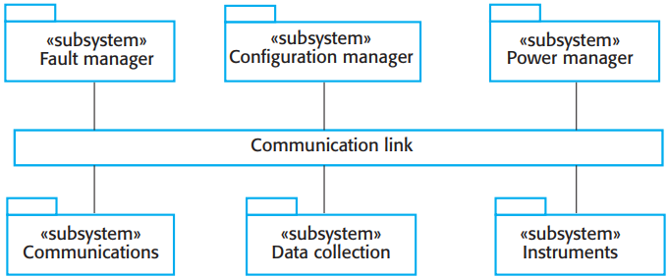
Chap. 7 Design and implementation
High-level architecture of the weather station
* The high-level architectural design for the weather station software is shown in Figure 7.4. The weather station is composed of independent subsystems that communicate by broadcasting messages on a common infrastructure, shown as Communication link in Figure 7.4. Each subsystem listens for messages on that infrastructure and picks up the messages that are intended for them.
* When the communications subsystem receives a control command, such as shutdown, the command is picked up by each of the other subsystems, which then shut themselves down in the correct way. The key benefit of this architecture is that it is easy to support different configurations of subsystems because the sender of a message does not need to address the message to a particular subsystem.

Slide 14

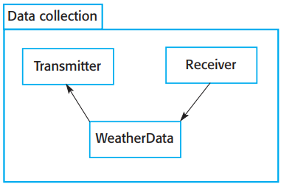
Chap. 7 Design and implementation
Architecture of data collection system
* Figure 7.5 shows the architecture of the data collection subsystem, which is included in Fig. 7.4.
* The Transmitter and Receiver objects are concerned with managing communications, and the WeatherData object encapsulates the information that is collected from the instruments and transmitted to the weather information system.

Slide 15
Chap. 7 Design and implementation
Object class identification 对象类识别
Various ways of identifying object classes in object-oriented systems were suggested: 有各种对象类识别方法
Use a grammatical analysis of a natural language description of the system. Objects and attributes are nouns; operations or services are verbs; 自然语言的语法分析
Use tangible entities in the application domain such as aircraft, roles such as manager, events such as request, interactions such as meetings, locations such as offices, organizational units such as companies, and so on; 其他
Use a scenario-based analysis where various scenarios of system use are identified and analyzed in turn. As each scenario is analyzed, the team must identify the required objects, attributes, and operations. 基于场景的分析

Slide 16
Chap. 7 Design and implementation
In practice
You have to use several knowledge sources to discover object classes. 需要采用多种知识来源
Object classes, attributes, and operations that are initially identified from the informal system description can be a starting point for the design. 以初始从非正式系统描述的识别结果(对象类、属性、操作)为起点
Information from application domain knowledge or scenario analysis may then be used to refine and extend the initial objects. 然后采用来自应用领域知识或场景分析的信息，细化和扩展初始对象
This information can be collected from requirements documents, discussions with users, or analyses of existing systems. 信息收集来源：需求文档、与用户讨论、分析现有系统

Slide 17
Chap. 7 Design and implementation
Weather station object classes 气象站对象类
In the wilderness weather station, object identification is based on the tangible hardware in the system. See Figure 7.6: 基于有形的硬件来识别对象
WeatherStation: This object class provides basic interface of the weather station with its environment. It reflects interactions identified in the use-case model in Figure 7.3.
WeatherData: This object class is used for processing the report weather command. It sends the summarized data from the weather station instruments to the weather information system.
Ground thermometer, Anemometer, Barometer: These object classes are directly related to instruments in the system. They reflect tangible hardware entities and the operations are concerned with controlling that hardware.

Slide 18

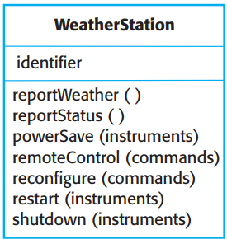
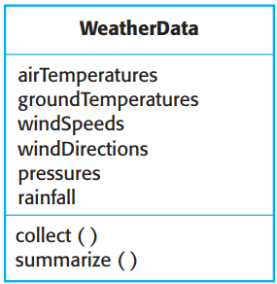
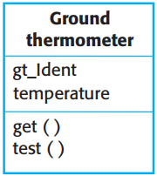
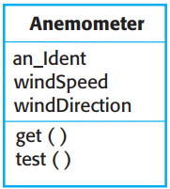
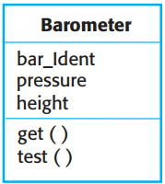
Weather station object classes
* Once you have identified the objects, you then refine the object design. You look for common features and then design inheritance hierarchy.
* For example, you may identify an Instrument superclass, which defines the common features of all instruments, such as an identifier, and get and test operations. You may also add new attributes and operations to the superclass.

Slide 19
Chap. 7 Design and implementation
Design models 设计模型
Design models show the objects or object classes in a system, and associations and relationships between these entities. 含义:对象/对象类及其相互关联和关系
These models are the bridge between the system requirements and the implementation. they should: be abstract so that unnecessary detail doesn’t hide relationships between them and requirements; include enough detail for programmers to make decisions.是系统需求与实现之间的桥梁
When using the UML, you may develop two kinds of design model: 使用UML时，要开发两种设计模型
Structural models: Describe the static structure of the system using object classes and their relationships. 结构模型
Dynamic models: Describe the dynamic structure of the system and show the expected runtime interactions between the system objects. 动态模型

Slide 20
Chap. 7 Design and implementation
Three UML model types are particularly useful for adding detail to use case and architectural models: 三种UML模型，对向用例和结构模型加入细节尤其有用
Subsystem models, which show logical groupings of objects into coherent subsystems. These are represented using a form of class diagram with each subsystem shown as a package with enclosed objects. Subsystem models are structural models. 子系统模型
Sequence models, which show the sequence of object interactions. These are represented using a UML sequence or a collaboration diagram. Sequence models are dynamic models. 顺序模型
State machine models, which show how objects change their state in response to events. These are represented in the UML using state diagrams. State machine models are dynamic models. 状态机模型

Slide 21
Chap. 7 Design and implementation
Subsystem models 子系统模型
It is a static model that shows how a design is organized into logically related groups of objects. This type of model is shown in Figure 7.4 to present the subsystems in the weather mapping system. 是静态模型，展示系统如何被组织成逻辑上相关的对象组的
You may also design detailed object models, showing the objects in the systems and their associations (inheritance, generalization, aggregation, etc.). However, there is a danger in doing too much modeling. You should not make detailed decisions about the implementation that are really best left until the system is implemented. 也可以设计详细的对象模型，展示系统中的对象及关联(继承、泛化、聚合，等等)

Slide 22
Chap. 7 Design and implementation
Sequence models 顺序模型
Sequence models are dynamic models that describe the sequence of object interactions that take place. When documenting a design, you should produce a sequence model for each significant interaction. If you have developed a use case model, then there should be a sequence model for each use case that you have identified. 是动态模型，描述对象发生交互的序列
Figure 7.7 is an example of a sequence model, shown as a UML sequence diagram. This diagram shows the sequence of interactions that take place when an external system requests the summarized data from the weather station. You read sequence diagrams from top to bottom: 例子

Slide 23
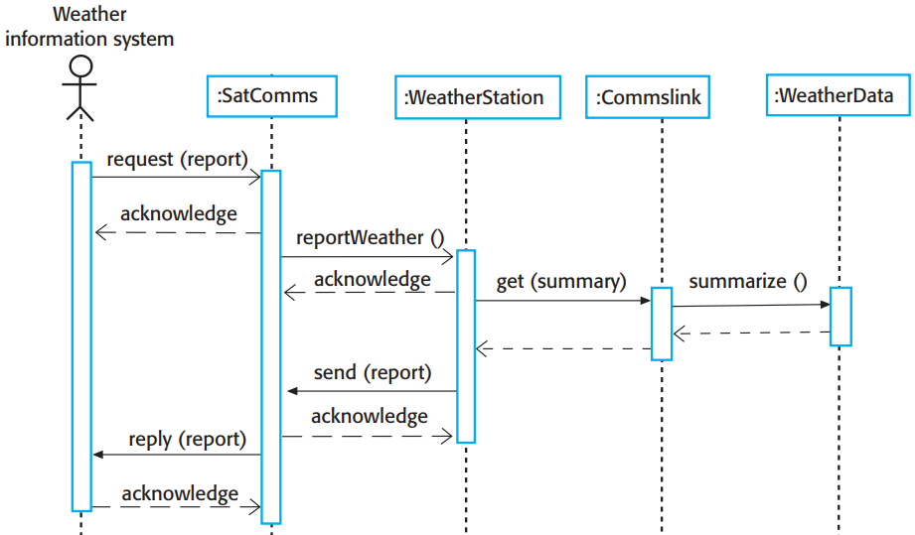

1. The SatComms object receives a request from the weather information system to collect a weather report from a weather station. It acknowledges receipt of this request. The stick arrowhead on the sent message indicates that the external system does not wait for a reply but can carry on with other processing.
2. SatComms sends a message to WeatherStation, via a satellite link, to create a summary of the collected weather data. Again, the stick arrowhead indicates that SatComms does not suspend itself waiting for a reply.
3. WeatherStation sends a message to a Commslink object to summarize the weather data. In this case, the squared-off style of arrowhead indicates that the instance of the WeatherStation object class waits for a reply.
4. Commslink calls the summarize method in the object WeatherData and waits for a reply.
5. The weather data summary is computed and returned to WeatherStation via the Commslink object.
6. WeatherStation then calls the SatComms object to transmit the summarized data to the weather information system, through the satellite communications system.

Slide 24
Chap. 7 Design and implementation
State machine model 状态机模型
A state machine model shows how the object changes state depending on the messages that it receives. UML includes state diagrams to describe state machine models. 含义:展示对象根据接收消息而改变状态
Figure 7.8 is a state diagram for the weather station system. 例子
State diagrams are useful high-level models of a system or an object’s operation. However, you don’t need a state diagram for all of the objects in the system. Many system objects in a system are simple, and their operation can be easily described without a state model. 有用的高级别模型；无需为所有对象建立状态图

Slide 25
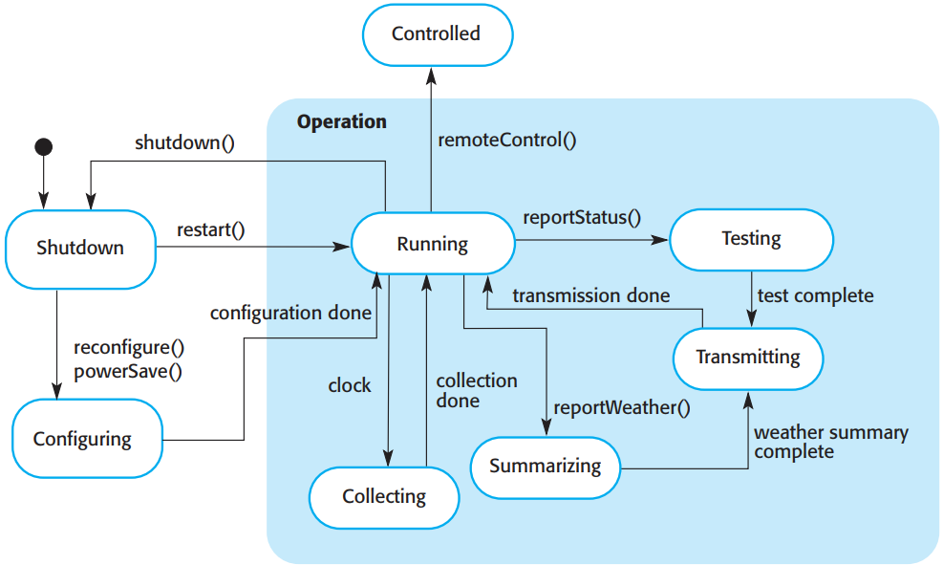

1. If the system state is Shutdown, then it can respond to a restart(), a reconfigure() or a powerSave() message. The unlabeled arrow with the black blob indicates that the Shutdown state is the initial state. A restart() message causes a transition to normal operation. Both the powerSave() and reconfigure() messages cause a transition to a state in which the system reconfigures itself. The state diagram shows that reconfiguration is allowed only if the system has been shut down.
2. In the Running state, the system expects further messages. If a shutdown() message is received, the object returns to the shutdown state.
3. If a reportWeather() message is received, the system moves to the Summarizing state. When the summary is complete, the system moves to a Transmitting state where the information is transmitted to the remote system. It then returns to the Running state.
4. If a signal from the clock is received, the system moves to the Collecting state, where it collects data from the instruments. Each instrument is instructed in turn to collect its data from the associated sensors.
5. If a remoteControl() message is received, the system moves to a controlled state in which it responds to a different set of messages from the remote control room. These are not shown on this diagram.

Slide 26
Chap. 7 Design and implementation
Interface specification 接口规格说明
Interfaces between components are specified so that objects and subsystems can be designed in parallel. 刻画接口后，对象和子系统可以并行设计
Interface design is concerned with specifying the detail of the interface to an object or to a group of objects. Interfaces can be specified in UML similar to class diagram, but with no attribute section, and UML stereotype «interface» should be included. 接口设计关注刻画接口细节
Interface design should not include details of the data representation, but should include operations to access and update data. 不应包括数据表示细节,但应包括操作
There is not a simple 1:1 relationship between objects and interfaces. The same object may have several interfaces. Equally, a group of objects may all be accessed through a single interface. 对象与接口并非1:1关系

Slide 27

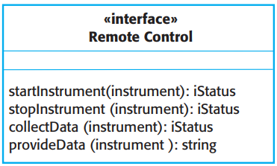
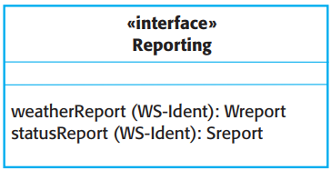
Chap. 7 Design and implementation
Weather station interfaces 气象站接口
* Fig. 7.9 shows two interfaces that may be defined for the weather station.
* The lefthand interface is a reporting interface that defines the operation names that are used to generate weather and status reports. These map directly to operations in the WeatherStation object.
* The remote control interface provides four operations, which map onto a single method in the WeatherStation object. In this case, the individual operations are encoded in the command string associated with the remoteControl method, shown in Figure 7.6.

Slide 28
Chap. 7 Design and implementation
7.2 Design patterns 设计模式
The pattern is a description of the problem and the essence of its solution, so that the solution may be reused in different settings. Patterns are a way of reusing the knowledge and experience of other designers. 模式：问题描述+解决方案精髓，因而可复用
Design patterns are usually associated with object-oriented design. Published patterns often rely on object characteristics such as inheritance and polymorphism to provide generality. However, the general principle of encapsulating experience in a pattern is one that is equally applicable to any kind of software design. 设计模式通常与面向对象设计相关联

Slide 29
Chap. 7 Design and implementation
The Gang of Four defined the four essential elements of design patterns in their book on patterns: “四人帮”定义的设计模式的4个基本要素
A name, a meaningful reference to the pattern. 名字
A description of the problem area that explains when the pattern may be applied. 可适用的问题域的描述
A solution description of the parts of the design solution, their relationships and their responsibilities. This is not a concrete design description. It is a template for a design solution that can be instantiated in different ways. 各部分解决方案的描述，及其相互关系和职责
A statement of the consequences—the results and trade-offs—of applying the pattern. This can help designers understand whether or not a pattern can be used in a particular situation.后果陈述:采用模式的结果和权衡

Slide 30
Chap. 7 Design and implementation
The Observer pattern 观察者模式
Shown in Fig. 7.10, here use the four essential description elements and also include a brief statement of what the pattern can do. 4个基本描述元素
This pattern can be used in situations where different presentations of an object’s state are required. 用于对象状态的不同展示
It separates the object that must be displayed from the different forms of presentation. 将对象与不同形式的展示分离
This is illustrated in Fig. 7.11, which shows two different graphical presentations of the same dataset. 同一个数据集的2个图形表示

Slide 31
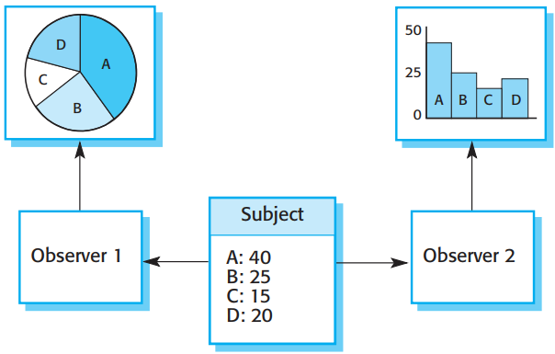

Chap. 7 Design and implementation
Multiple displays using the Observer pattern 采用观察者模式的多种呈现方式

Slide 32

Chap. 7 Design and implementation
The Observer pattern (1)
Pattern name 模式名 | Observer
Description 描述 | Separates the display of the state of an object from the object itself and allows alternative displays to be provided. When the object state changes, all displays are automatically notified and updated to reflect the change.
Problem description 问题描述 | In many situations, you have to provide multiple displays of state information, such as a graphical display and a tabular display. Not all of these may be known when the information is specified. All alternative presentations should support interaction and, when the state is changed, all displays must be updated. This pattern may be used in situations where more than one display format for state information is required and where it is not necessary for the object that maintains the state information to know about the specific display formats used.

Slide 33
Chap. 7 Design and implementation
The Observer pattern (2)
Pattern name | Observer
Solution description 解决方案描述 | This involves two abstract objects, Subject and Observer, and two concrete objects, ConcreteSubject and ConcreteObject, which inherit the attributes of the related abstract objects. The abstract objects include general operations that are applicable in all situations. The state to be displayed is maintained in ConcreteSubject, which inherits operations from Subject allowing it to add and remove Observers (each observer corresponds to a display) and to issue a notification when the state has changed. The ConcreteObserver maintains a copy of the state of ConcreteSubject and implements the Update() interface of Observer that allows these copies to be kept in step. The ConcreteObserver automatically displays the state and reflects changes whenever the state is updated.
Consequences效果 | The subject only knows the abstract Observer and does not know details of the concrete class. Therefore there is minimal coupling between these objects. Because of this lack of knowledge, optimizations that enhance display performance are impractical. Changes to the subject may cause a set of linked updates to observers to be generated, some of which may not be necessary.

Slide 34
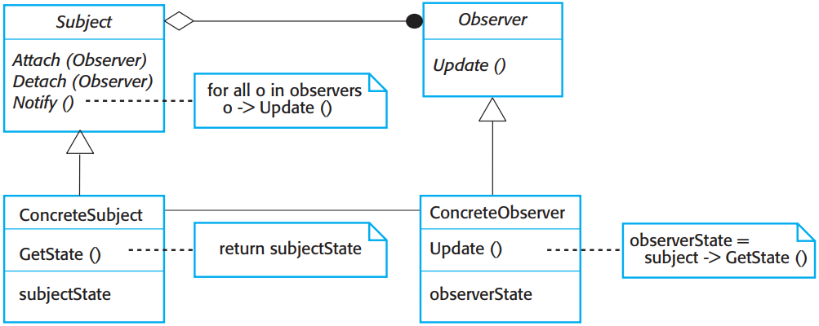

Chap. 7 Design and implementation
A UML model of the Observer pattern UML模型
* Graphical representations are normally used to illustrate the object classes in patterns and their relationships. These supplement the pattern description and add detail to the solution description.
* Figure 7.12 is the representation in UML of the Observer pattern.

Slide 35
Chap. 7 Design and implementation
Use patterns in design 在设计中使用模式
To use patterns in your design, you need to recognize that any design problem you are facing may have an associated pattern that can be applied. 需要意识到：你面临的任何设计问题，都有一个可应用的、关联的模式
Examples include: 例子
Tell several objects that the state of some other object has changed (Observer pattern). 观察者模式
Tidy up the interfaces to a number of related objects that have often been developed incrementally (Facade pattern). 门面模式
Provide a standard way of accessing the elements in a collection, irrespective of how that collection is implemented (Iterator pattern). 迭代器模式
Allow for the possibility of extending the functionality of an existing class at runtime (Decorator pattern). 装饰者模式

Slide 36
Chap. 7 Design and implementation
7.3 Implementation issues 实现问题
In system implementation, you create an executable version of the software. Implementation may involve developing programs in high- or low-level programming languages or tailoring and adapting generic, off-the-shelf systems to meet the specific requirements of an organization. 实现：创建可执行软件
The chapter is intended to offer a language-independent approach. 本章：提供语言无关的方法
Here introduces some aspects of implementation that are particularly important to software engineering and that are often not covered in programming texts. 这里介绍实现的一些方面

Slide 37
Chap. 7 Design and implementation
Some aspects of implementation: 实现的某些方面
Reuse: Most modern software is constructed by reusing existing components or systems. When you are developing software, you should make as much use as possible of existing code. 复用
Configuration management: During the development process, many different versions of each software component are created. If you don’t keep track of these versions in a configuration management system, you are liable to include the wrong versions of these components in your system. 配置管理
Host-target development: Production software does not usually execute on the same computer as the software development environment. Rather, you develop it on one computer (the host system) and execute it on a separate computer (the target system). The host and target systems are sometimes of the same type, but often they are completely different. 宿主机-目标机开发

Slide 38
Chap. 7 Design and implementation
7.3.1 Reuse(本节留作自学)
7.3.2 Configuration management(本节留作自学)
7.3.3 Host-target development(本节留作自学)
7.4 Open source development 开源开发(本节留作自学)

